Slide 1

CS 484: Introduction to Machine Learning
Week 12
November 11, 2020

Slide 2
Week 12 Agenda: Support Vector Machine
Motivation
Hyperplane
Support Vector

Slide 3
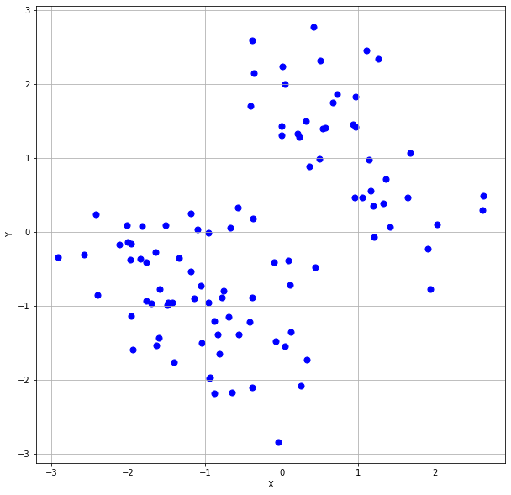

Can you See the Two Groups of Points?
100 Observations
Continuous Features X and Y

Slide 4

Discover The Two Groups
Two Clusters?
Check with Elbow and Silhouette Charts
K-Means Clustering

Slide 5
K-Means Cluster
nObs = trainData.shape[0]
for c in range(maxNClusters):
KClusters = c + 1
nClusters[c] = KClusters
kmeans = cluster.KMeans(n_clusters=KClusters, random_state=20191106).fit(trainData)
if (1 < KClusters):
Silhouette[c] = metrics.silhouette_score(trainData, kmeans.labels_)
else:
Silhouette[c] = numpy.NaN
WCSS = numpy.zeros(KClusters)
nC = numpy.zeros(KClusters)
for i in range(nObs):
k = kmeans.labels_[i]
nC[k] += 1
diff = trainData.iloc[i] - kmeans.cluster_centers_[k]
WCSS[k] += diff.dot(diff)
Elbow[c] = 0
for k in range(KClusters):
Elbow[c] += WCSS[k] / nC[k]
TotalWCSS[c] += WCSS[k]
Week 12 Discover MVN100.py

Slide 6
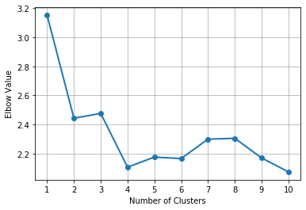
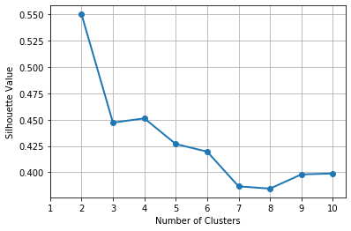
Discover The Two Groups
Number of Clusters | Elbow | Silhouette
1 | 3.1515
2 | 2.4432 | 0.5500
3 | 2.4763 | 0.4472
4 | 2.1064 | 0.4512
5 | 2.1758 | 0.4269
6 | 2.1658 | 0.4197
7 | 2.2993 | 0.3867
8 | 2.3051 | 0.3846
9 | 2.1702 | 0.3980
10 | 2.0741 | 0.3989
Go with the Two-Cluster solution!

Slide 7
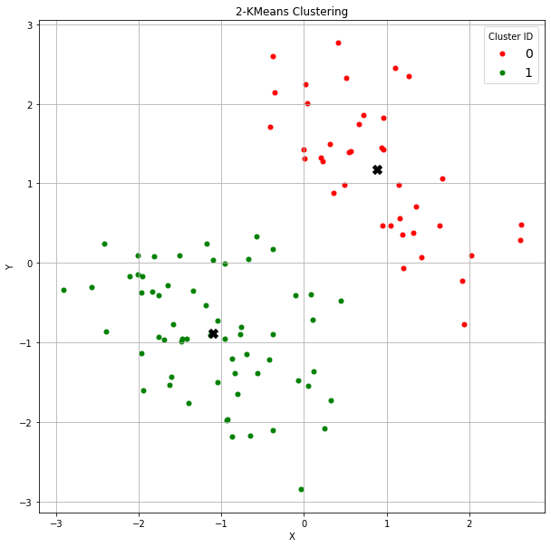
The Two-Cluster Solution
Cluster 0 Centroid
X = -1.10193414
Y = -0.88805487
Cluster 1 Centroid
X = 0.88152581
Y = 1.17125693

Slide 8
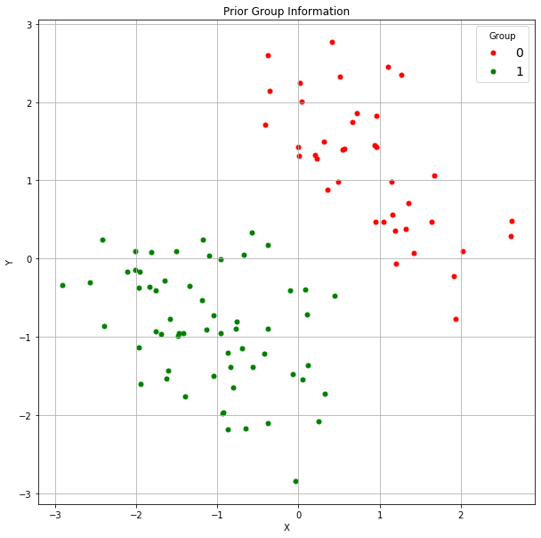

Identify The Two Groups
Logistic Regression
Nearest Neighbors
Decision Tree
Neural Network
Provided Prior Group Identifier

Slide 9
Nearest Neighbors
xTrain = trainData[['X','Y']]
yTrain = trainData['Group']
kNN_accuracy = numpy.zeros((20,2))
for k in numpy.arange(1,21,1):
neigh = kNN.KNeighborsClassifier(n_neighbors=k, algorithm = 'brute', metric = 'euclidean')
nbrs = neigh.fit(xTrain, yTrain)
# See the classification result
kNN_accuracy[k-1,0] = k
kNN_accuracy[k-1,1] = neigh.score(xTrain, yTrain)
neigh = kNN.KNeighborsClassifier(n_neighbors=2, algorithm = 'brute', metric = 'euclidean')
nbrs = neigh.fit(xTrain, yTrain)
trainData['_PredictedClass_'] = nbrs.predict(xTrain)
kNN_Mean = trainData.groupby('_PredictedClass_').mean()

Slide 10
Nearest Neighbors
Number of Neighbors | Accuracy
1 | 100%
2 | 100%
3 | 100%
4 | 100%
5 | 100%
6 | 100%
7 | 100%
8 | 100%
9 | 100%
10 | 100%
Number of Neighbors | Accuracy
11 | 100%
12 | 100%
13 | 100%
14 | 100%
15 | 100%
16 | 100%
17 | 100%
18 | 100%
19 | 100%
20 | 100%
The 1-Neighbor solution is as good as the 20-Neighbors solution!

Slide 11
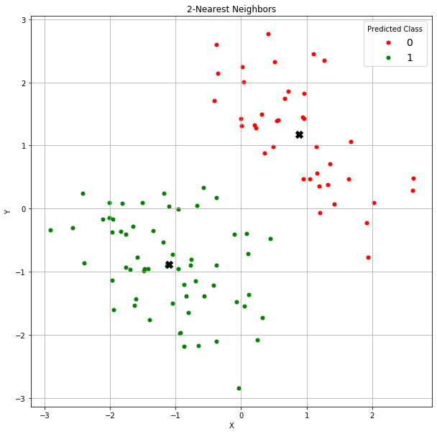
The Two-Neighbors Solution
Group 0 Centroid
X = -1.10193414
Y = -0.88805487
Group 1 Centroid
X = 0.88152581
Y = 1.17125693

Slide 12
Classification Tree
xTrain = trainData[['X','Y']]
yTrain = trainData['Group']
tree_accuracy = numpy.zeros((10,2))
for k in numpy.arange(1,11,1):
objTree = tree.DecisionTreeClassifier(criterion='entropy', max_depth=k, random_state=20191106)
thisFit = objTree.fit(xTrain, yTrain)
tree_accuracy[k-1,0] = k
tree_accuracy[k-1,1] = objTree.score(xTrain, yTrain)
objTree = tree.DecisionTreeClassifier(criterion='entropy', max_depth=2, random_state=20191106)
thisFit = objTree.fit(xTrain, yTrain)
y_predProb = thisFit.predict_proba(xTrain)
trainData['_PredictedClass_'] = numpy.where(y_predProb[:,1] >= y_threshold, 1, 0)
tree_Mean = trainData.groupby('_PredictedClass_').mean()

Slide 13
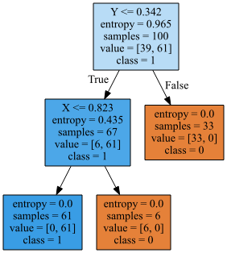
Classification Tree
Maximum Depths | Accuracy
1 | 94%
2 | 100%
3 | 100%
4 | 100%
5 | 100%
6 | 100%
7 | 100%
8 | 100%
9 | 100%
10 | 100%
Go with the classification tree with depth two!

Slide 14
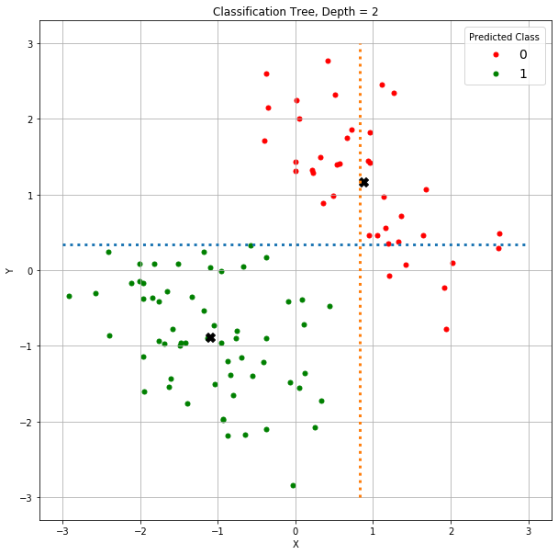
The Depth-Two Tree Solution
Group 0 Centroid
X = -1.10193414
Y = -0.88805487
Y = 0.342
Group 1 Centroid
X = 0.88152581
Y = 1.17125693
X = 0.823

Slide 15
Logistic Regression Model (BFGS)
xTrain = trainData[['X','Y']]
yTrain = trainData['Group']
xTrain = sm.add_constant(xTrain, prepend=True)
logit = sm.MNLogit(yTrain, xTrain)
print("Name of Target Variable:", logit.endog_names)
print("Name(s) of Predictors:", logit.exog_names)
thisFit = logit.fit(method='bfgs', full_output = True, maxiter = 100, tol = 1e-8, retall = True)
print(thisFit.summary())
y_predProb = thisFit.predict(xTrain)
trainData['_PredictedClass_'] = numpy.where(y_predProb[1] >= y_threshold, 1, 0)

Slide 16
Logistic Regression Model (BFGS)
Optimization terminated successfully.
Current function value: 0.000007
Iterations: 20
Function evaluations: 21
Gradient evaluations: 21
MNLogit Regression Results
==============================================================================
Dep. Variable: Group No. Observations: 100
Model: MNLogit Df Residuals: 97
Method: MLE Df Model: 2
Date: Tue, 05 Nov 2019 Pseudo R-squ.: 1.000
Time: 13:33:35 Log-Likelihood: -0.00070161
converged: True LL-Null: -66.875
Covariance Type: nonrobust LLR p-value: 9.056e-30
==============================================================================
Group=1 coef std err z P>|z| [0.025 0.975]
------------------------------------------------------------------------------
const 6.3861 758.388 0.008 0.993 -1480.028 1492.800
X -25.2173 4670.709 -0.005 0.996 -9179.639 9129.204
Y -25.3037 5896.582 -0.004 0.997 -1.16e+04 1.15e+04
==============================================================================
0% Misclassification Rate
Signs of a Complete Separation
Almost zero Log-Likelihood
Large coefficients and standard errors
Newton-Raphson method did not converge

Slide 17

The Logistic Regression Solution
Group 0 Centroid
X = -1.10193414
Y = -0.88805487
Group 1 Centroid
X = 0.88152581
Y = 1.17125693

Slide 18
MLP Neural Network
result = pandas.DataFrame(columns = ['nLayer', 'nHiddenNeuron', 'Loss', 'Accuracy'])
for nLayer in numpy.arange(1,5):
for nHiddenNeuron in numpy.arange(1,11,1):
nnObj = nn.MLPClassifier(hidden_layer_sizes = (nHiddenNeuron,)*nLayer,
activation = 'relu', verbose = False,
solver = 'lbfgs', learning_rate_init = 0.1,
max_iter = 5000, random_state = 20191106)
# nnObj.out_activation_ = 'identity'
thisFit = nnObj.fit(xTrain, yTrain)
y_predProb = nnObj.predict_proba(xTrain)
y_pred = numpy.where(y_predProb[:,1] >= y_threshold, 1, 0)
mlp_loss = nnObj.loss_
mlp_accuracy = metrics.accuracy_score(yTrain, y_pred)
result = result.append(pandas.DataFrame([[nLayer, nHiddenNeuron, mlp_loss, mlp_accuracy]],
columns = ['nLayer', 'nHiddenNeuron', 'Loss', 'Accuracy']))

Slide 19
MLP Neural Network
nLayer | nHiddenNeuron | Loss | Accuracy
1 | 1 | 0.0001242 | 1
1 | 2 | 0.6687501 | 0.39
1 | 3 | 0.0000759 | 1
1 | 4 | 0.0001625 | 1
1 | 5 | 0.0000736 | 1
1 | 6 | 0.0000629 | 1
1 | 7 | 0.0000845 | 1
1 | 8 | 0.0001053 | 1
1 | 9 | 0.0000968 | 1
1 | 10 | 0.0000668 | 1
2 | 1 | 0.0000821 | 1
2 | 2 | 0.0000977 | 1
2 | 3 | 0.0000969 | 1
2 | 4 | 0.0000759 | 1
2 | 5 | 0.0000427 | 1
2 | 6 | 0.0000385 | 1
2 | 7 | 0.0000448 | 1
2 | 8 | 0.0000511 | 1
2 | 9 | 0.0000343 | 1
2 | 10 | 0.0000621 | 1
nLayer | nHiddenNeuron | Loss | Accuracy
3 | 1 | 0.6687526 | 0.61
3 | 2 | 0.0001152 | 1
3 | 3 | 0.0000408 | 1
3 | 4 | 0.0000347 | 1
3 | 5 | 0.0000541 | 1
3 | 6 | 0.0000487 | 1
3 | 7 | 0.0000326 | 1
3 | 8 | 0.0000583 | 1
3 | 9 | 0.0000481 | 1
3 | 10 | 0.0000612 | 1
4 | 1 | 0.6687521 | 0.61
4 | 2 | 0.0001775 | 1
4 | 3 | 0.0000576 | 1
4 | 4 | 0.0000477 | 1
4 | 5 | 0.0000943 | 1
4 | 6 | 0.6345626 | 0.39
4 | 7 | 0.0000433 | 1
4 | 8 | 0.0000376 | 1
4 | 9 | 0.0000464 | 1
4 | 10 | 0.0000532 | 1
Minimum Loss Configuration: Number of Layers = 3, Number of Hidden Neurons = 7

Slide 20
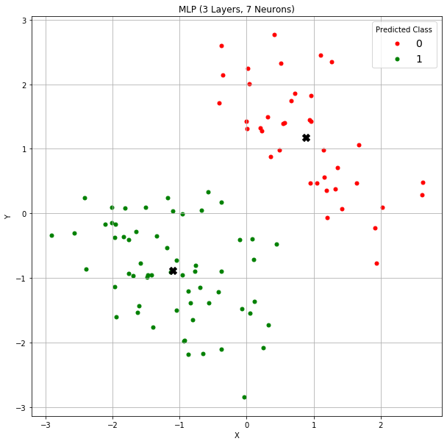
The MLP Neural Network Solution
Group 0 Centroid
X = -1.10193414
Y = -0.88805487
Group 1 Centroid
X = 0.88152581
Y = 1.17125693

Slide 21

Two Groups Obviously
Nearest Neighbors
Decision Tree
K-Means Clustering
Logistic Regression
MLP Neural Network

Slide 22
Personas of Algorithms
K-Means
A “Follow the Leaders” algorithm
The leaders are the clusters’ centroids
Nearest Neighbor
A “Crowd-sourcing” algorithm
The crowd consists of the neighbors
Decision Tree
A “Divide and Conquer” algorithm
Recursively divide the observations into smaller groups of the same or related observations
An observation is assigned to the cluster if the observation is closest to the cluster’s centroid
An observation takes the majority opinion of the crowd
An observation take the majority identity of the group

Slide 23
Personas of Algorithms
Logistic Regression
A “Personality Test” algorithm
Each attribute individually contributes to the log-odds of belonging to a particular target class
Neural Network
A “Black Box” algorithm
An observation is assigned to the most-likely class
The hidden layers and their neurons exist only if you believe in them
Recursively approximate complex relationship by simple and manageable functions

Slide 24
Pros and Cons of the Algorithms
Algorithm | Pros | Cons
K-Means | Only need the centroids for prediction | The predictions are reliable only if the number of clusters is correct. Need to calculate the distance metric.
Nearest Neighbor | Only need to determine the number of neighbors. A instance/memory-based learning model | The predictions are reliable only if the number of neighbors is correct for every observation. Need to calculate the distance metric. Need to carry the whole training data for prediction.
Decision Tree | Only need to know the splitting criteria. Involve only one feature for splitting. | The boundaries of the data segments are always parallel to an axis. Need to know when to stop

Slide 25
Pros and Cons of the Algorithms
Algorithm | Pros | Cons
Multinomial Logistic | Only need to know the parameter estimates (i.e., the weights). Allows us to visualize the impacts of the attributes on the predictions. | Correlations among attributes have to be explicitly specified in the model. May suffer from non-convergence and floating-point numerical problems.
Neural Network | Allow us to arbitrarily add layers and neurons without making the interpretation more complex (afterall, there is no interpretation) | The number of synaptic weights increases exponentially with the number of layers and neurons May suffer from non-convergence and floating-point numerical problems.

Slide 26
Outcomes of Classification Algorithms
Assignment to a Target Class
Likelihood from a Target Class
Set the Boundary Between Target Classes

Slide 27
Set-the-Boundary Type Algorithm
Introduce the Support Vector Machine
Don’t
Need to know the characteristics (e.g., means and standard deviations) of the target class populations
Need to know the likelihood of belonging to a population
Need to carry the training data everywhere for prediction
Need to calculate the distance metric or the logit
Need to go through iterations to obtain the parameter estimates
Do
Work well for future observations
Need only simple arithmetic calculations for classification

Slide 28

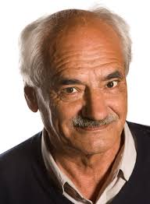
History of Support Vector Machines
In 1963, Vladimir N. Vapnik and Alexey Y. Chervonenkis invented the original Support Vector Machines algorithm at the Institute of Control Sciences of the Russian Academy of Sciences, Moscow, Russia.
In 1992, Bernhard E. Boser, Isabelle M. Guyon, and Vladimir N. Vapnik improved the original support vector machine which allows for the creation of nonlinear classifiers.
Vapnik (1936-present)
https://www.kdnuggets.com/2016/07/guyon-data-mining-history-svm-support-vector-machines.html
https://link.springer.com/chapter/10.1007%2F978-3-642-41136-6_3
Chervonenkis (1938-2014)

Slide 29
Overview of Support Vector Machines
A machine is a device or an algorithm that performs a particular task with a definite goal
Can successfully solve many classification problems
A classifier defined by a hyperplane
A large-margin linear classifier

Slide 30
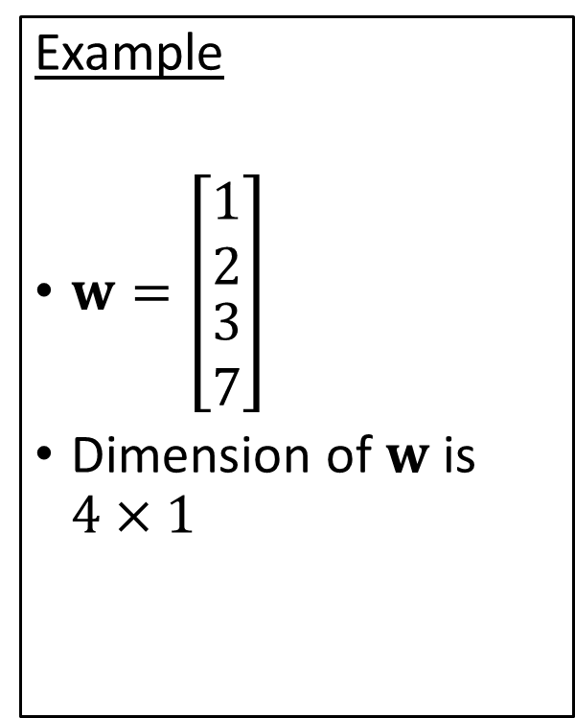
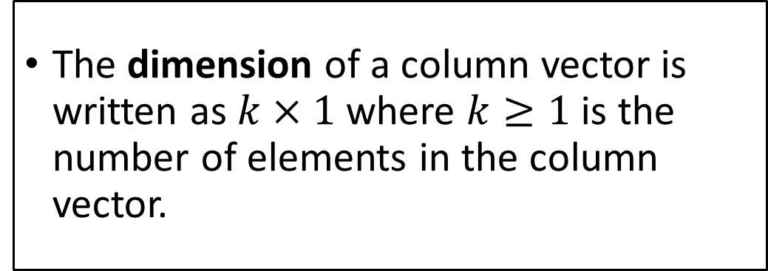
Matrix Algebra: Column Vector
A column vector is an array of numbers that are listed as a column.
Denote the column vector in boldface
Example
$w=\left[\begin{matrix}1 \\ 2 \\ \begin{aligned}3 \\ 7\end{aligned}\end{matrix}\right]$
Dimension of $w$ is $4×1$
The dimension of a column vector is written as $k×1$ where $k≥1$ is the number of elements in the column vector.

Slide 31
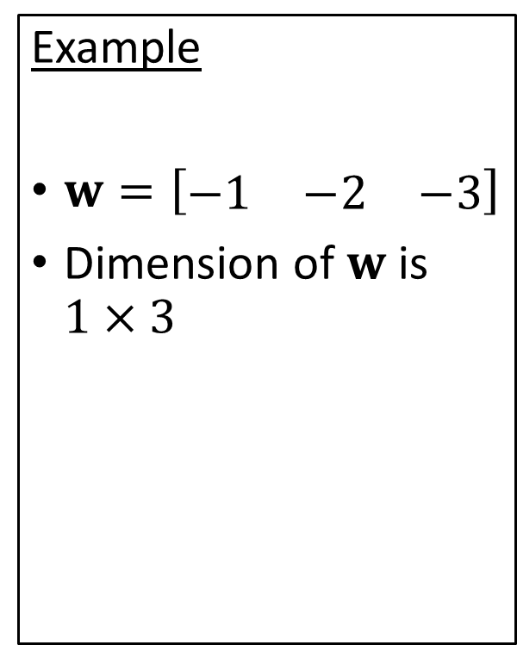
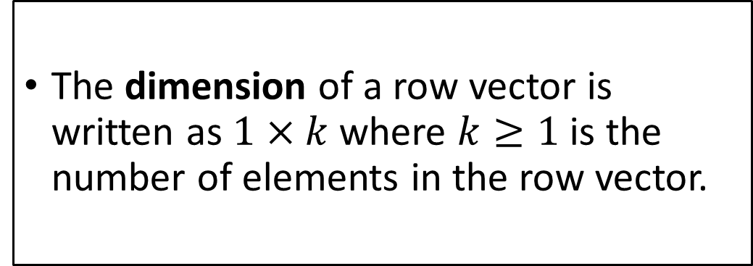
Matrix Algebra: Row Vector
A row vector is an array of numbers that are listed as a row.
Denote the row vector in boldface
Example
$w=\left[\begin{matrix}−1 & −2 & −3\end{matrix}\right]$
Dimension of $w$ is $1×3$
The dimension of a row vector is written as $1×k$ where $k≥1$ is the number of elements in the row vector.

Slide 32
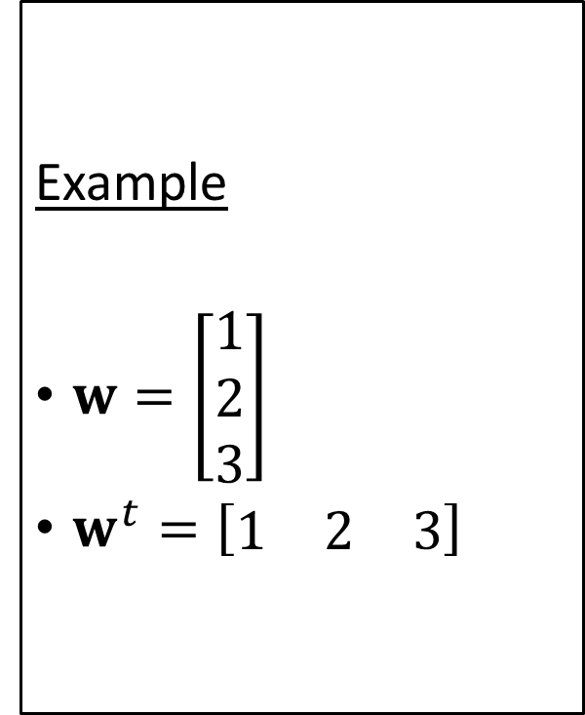
Matrix Algebra: Transpose Operator
The Transpose operator transforms a column vector to a row vector, and vice versa
Denote by a superscript t
Example
$w=\left[\begin{aligned}1 \\ 2 \\ 3\end{aligned}\right]$
$w^{t}=\left[\begin{matrix}1 & 2 & 3\end{matrix}\right]$
In general, the Transpose operator interchanges the row and the column dimensions

Slide 33
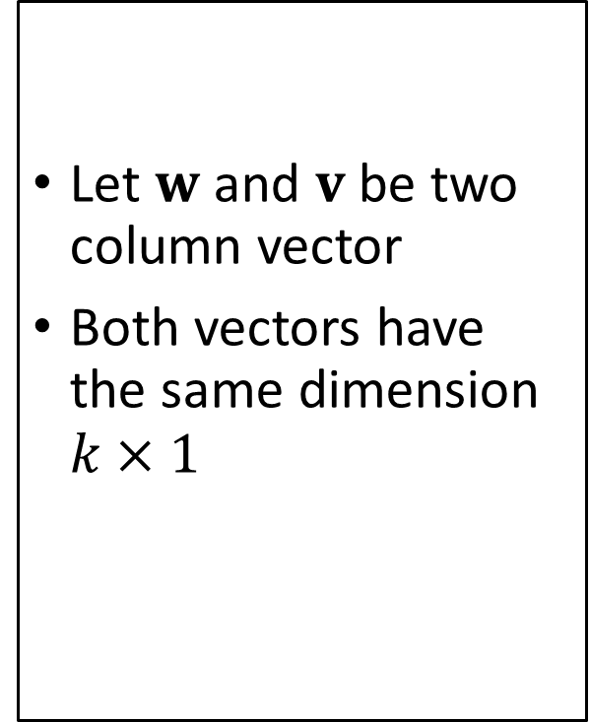
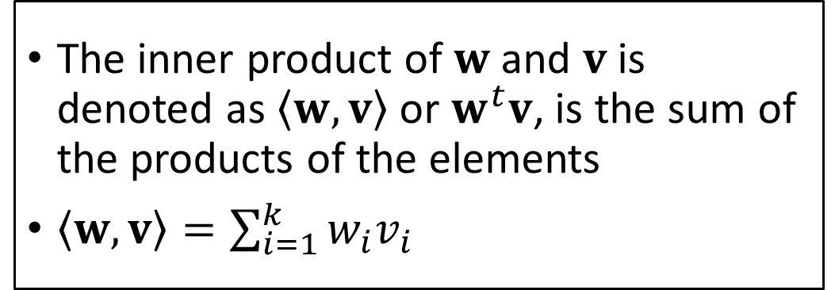
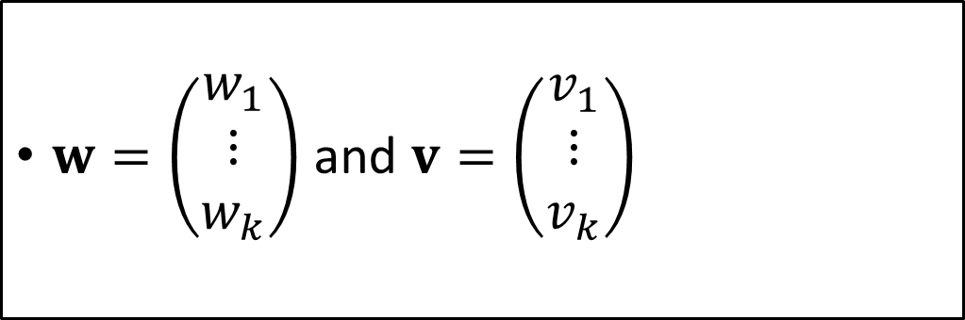
Matrix Algebra: Inner Product of Two Vectors
Let $w$ and $v$be two column vector
Both vectors have the same dimension $k×1$
$w=\left(\begin{matrix}w_{1} \\ ⋮ \\ w_{k}\end{matrix}\right)$ and $v=\left(\begin{matrix}v_{1} \\ ⋮ \\ v_{k}\end{matrix}\right)$
The inner product of $w$ and $v$is denoted as $\left\langle w,v\right\rangle$ or $w^{t}v$, is the sum of the products of the elements
$\left\langle w,v\right\rangle =\sum_{i=1}^{k}{w_{i}v_{i}}$

Slide 34
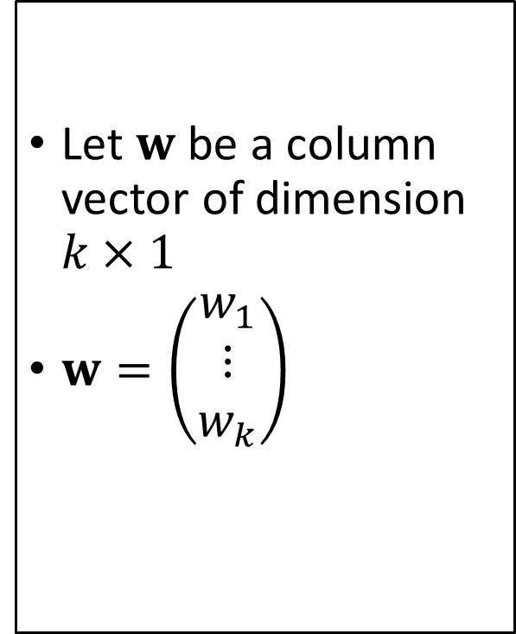
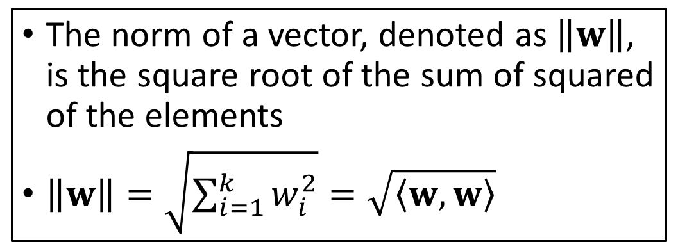
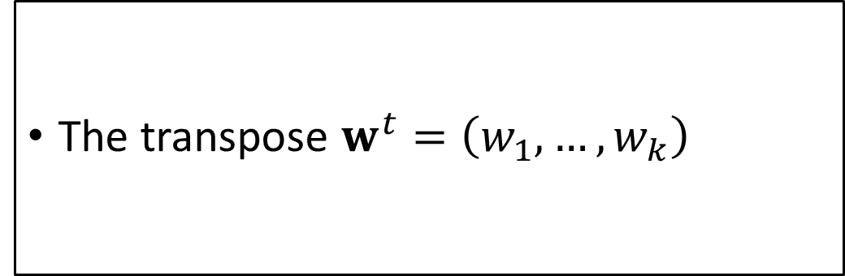
Matrix Algebra: Norm of a Vector
Let $w$ be a column vector of dimension $k×1$
$w=\left(\begin{matrix}w_{1} \\ ⋮ \\ w_{k}\end{matrix}\right)$
The transpose $w^{t}=\left(w_{1},…,w_{k}\right)$
The norm of a vector, denoted as $\left\|w\right\|$, is the square root of the sum of squared of the elements
$\left\|w\right\|=\sqrt{\sum_{i=1}^{k}{w_{i}^{2}}}=\sqrt{\left\langle w,w\right\rangle }$

Slide 35
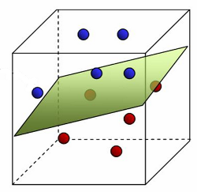
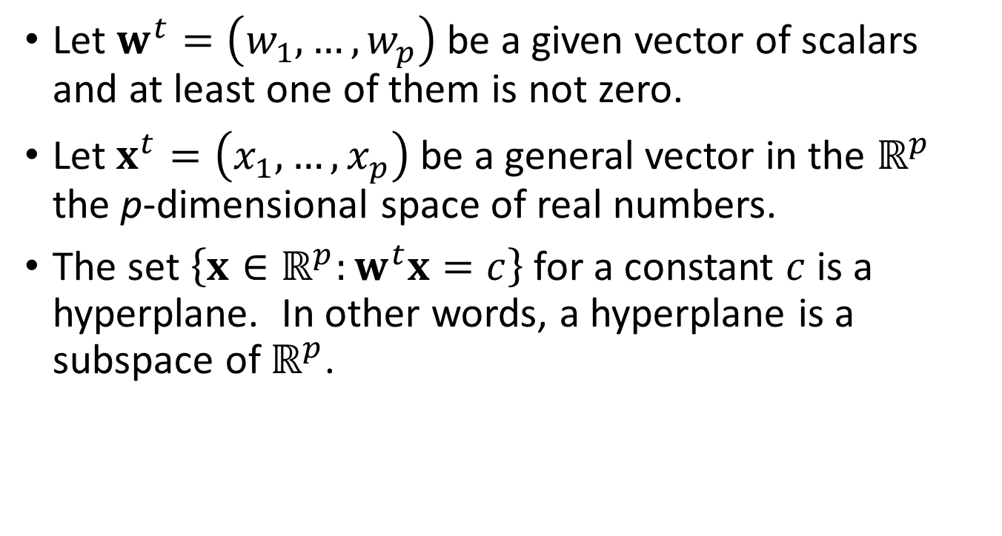
What is Hyperplane?
Let $w^{t}=\left(w_{1},…,w_{p}\right)$ be a given vector of scalars and at least one of them is not zero.
Let $x^{t}=\left(x_{1},…,x_{p}\right)$ be a general vector in the $ℝ^{p}$ the p-dimensional space of real numbers.
The set $\left\{x∈ℝ^{p}:w^{t}x=c\right\}$ for a constant $c$ is a hyperplane. In other words, a hyperplane is a subspace of $ℝ^{p}$.

Slide 36
Examples of a Hyperplane
One-dimensional, p = 1
It is a point ${w_{1}x}_{1}=c$, if $w_{1}≠0$ then $x_{1}=c/{w_{1}}$
It is a point 〖𝑤_1 𝑥〗_1=𝑐, if 𝑤_1≠0 then 𝑥_1=𝑐∕𝑤_1
Two-dimensional, p = 2
It is a line $w_{1}x_{1}+w_{2}x_{2}=c$ when $w_{1}≠0$ and $w_{2}≠0$
It is a line 𝑤_1 𝑥_1+𝑤_2 𝑥_2=𝑐 when 𝑤_1≠0 and 𝑤_2≠0
If $w_{1}=0$ or $w_{2}=0$(but not both), then this hyperplane reduces to a point
If 𝑤_1=0 or 𝑤_2=0 (but not both), then this hyperplane reduces to a point
Three-dimensional, p = 3
It is a plane $w_{1}x_{1}+w_{2}x_{2}+w_{3}x_{3}=c$ when $w_{1}≠0$, $w_{2}≠0$, and $w_{2}≠0$
It is a plane 𝑤_1 𝑥_1+𝑤_2 𝑥_2+𝑤_3 𝑥_3=𝑐 when 𝑤_1≠0, 𝑤_2≠0, and 𝑤_2≠0
Reduce to a hyperplane in a lower dimension if some $w_{i}=0$
Reduce to a hyperplane in a lower dimension if some 𝑤_𝑖=0
If $w_{1}=0$, then the hyperplane is undefined
If 𝑤_1=0, then the hyperplane is undefined

Slide 37
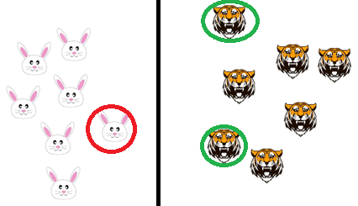
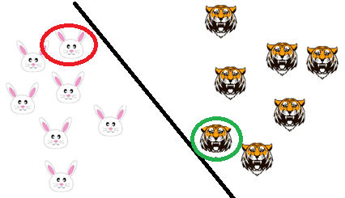
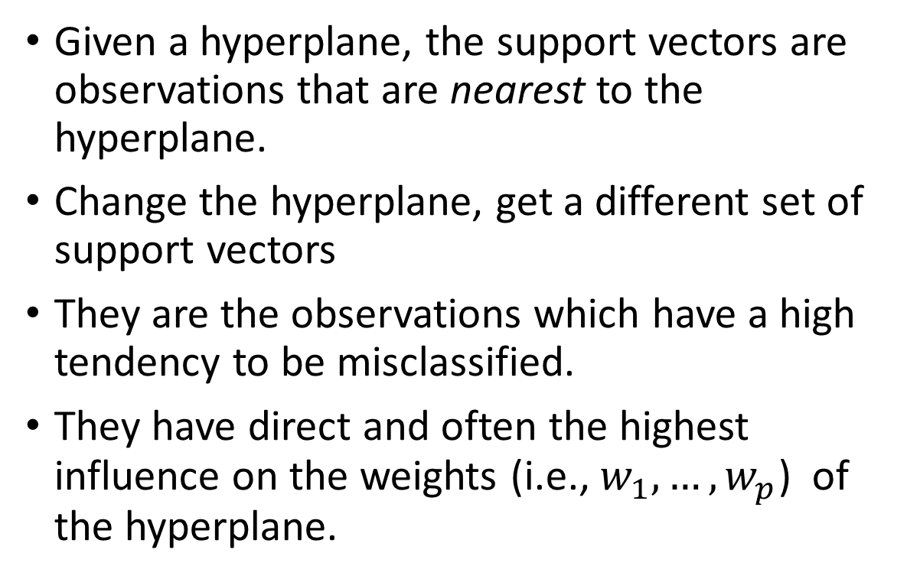
What are the Support Vectors?
Given a hyperplane, the support vectors are observations that are nearest to the hyperplane.
Change the hyperplane, get a different set of support vectors
They are the observations which have a high tendency to be misclassified.
They have direct and often the highest influence on the weights (i.e., $w_{1},…,w_{p}$) of the hyperplane.

Slide 38
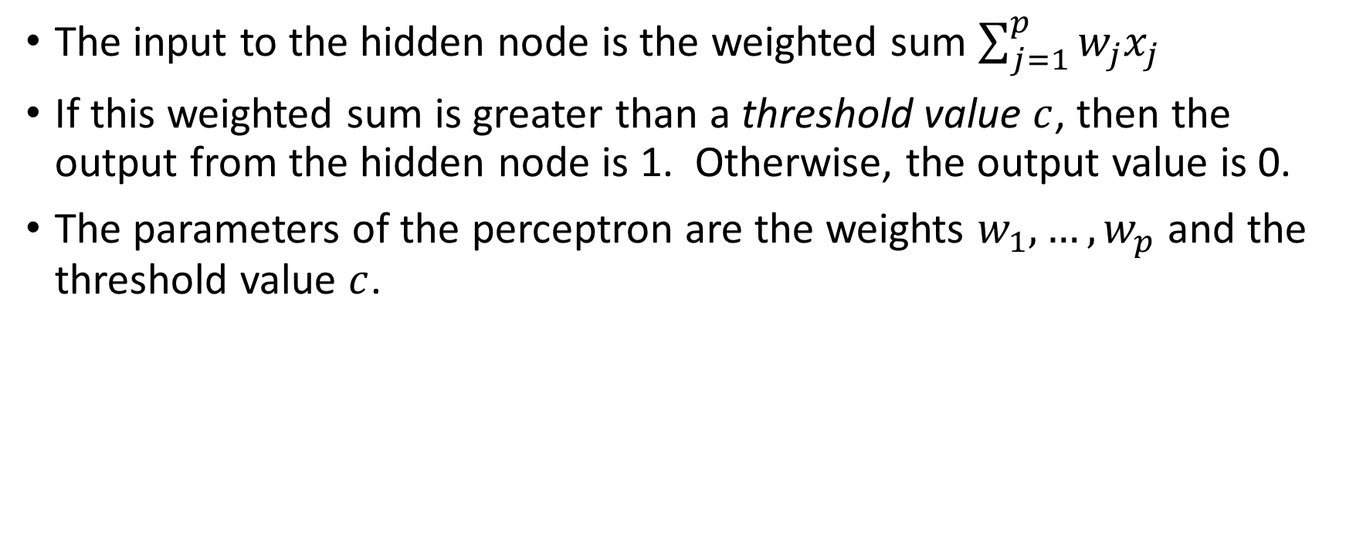
Perceptron: A Linear Separator
The input to the hidden node is the weighted sum $\sum_{j=1}^{p}{w_{j}x_{j}}$
If this weighted sum is greater than a threshold value $c$, then the output from the hidden node is 1. Otherwise, the output value is 0.
The parameters of the perceptron are the weights $w_{1},…,w_{p}$ and the threshold value $c$.

Slide 39
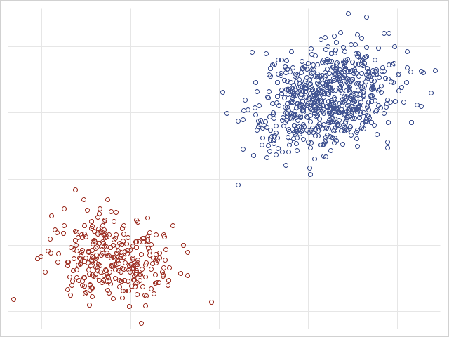
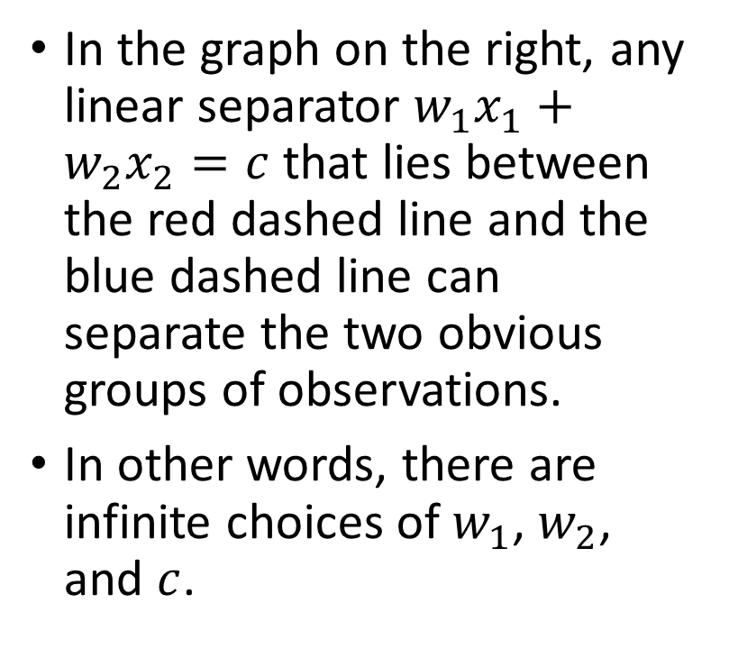
Which Linear Separator?
In the graph on the right, any linear separator $w_{1}x_{1}+w_{2}x_{2}=c$that lies between the red dashed line and the blue dashed line can separate the two obvious groups of observations.
In other words, there are infinite choices of $w_{1}$, $w_{2}$, and $c$.

Slide 40
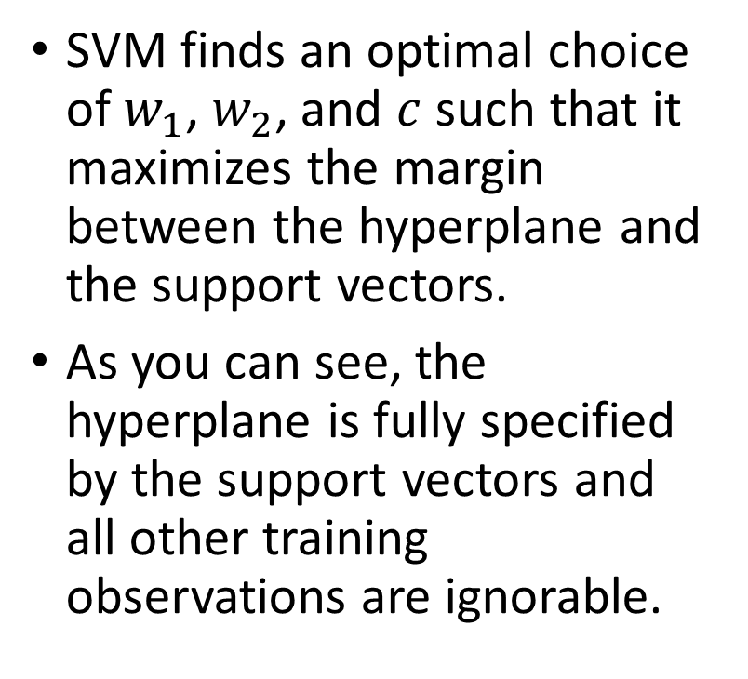
The Optimal Linear Separator
SVM finds an optimal choice of $w_{1}$, $w_{2}$, and $c$ such that it maximizes the margin between the hyperplane and the support vectors.
As you can see, the hyperplane is fully specified by the support vectors and all other training observations are ignorable.
Maximize Margin
Support Vectors

Slide 41
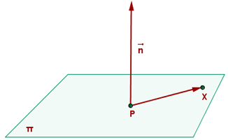
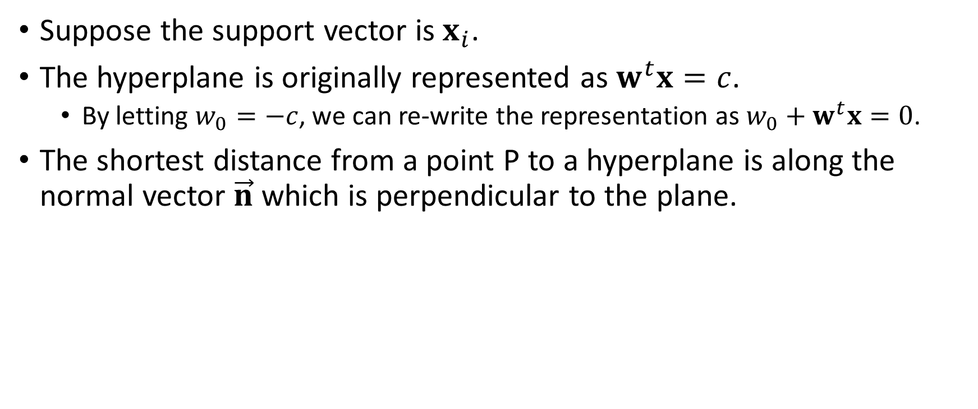
Distance from a Point to a Hyperplane (Advanced Material)
Suppose the support vector is $x_{i}$.
The hyperplane is originally represented as $w^{t}x=c$.
By letting $w_{0}=−c$, we can re-write the representation as $w_{0}+w^{t}x=0$.
The shortest distance from a point P to a hyperplane is along the normal vector $\vec{n}$ which is perpendicular to the plane.
Source: https://www.ditutor.com/space/normal_vector.html

Slide 42
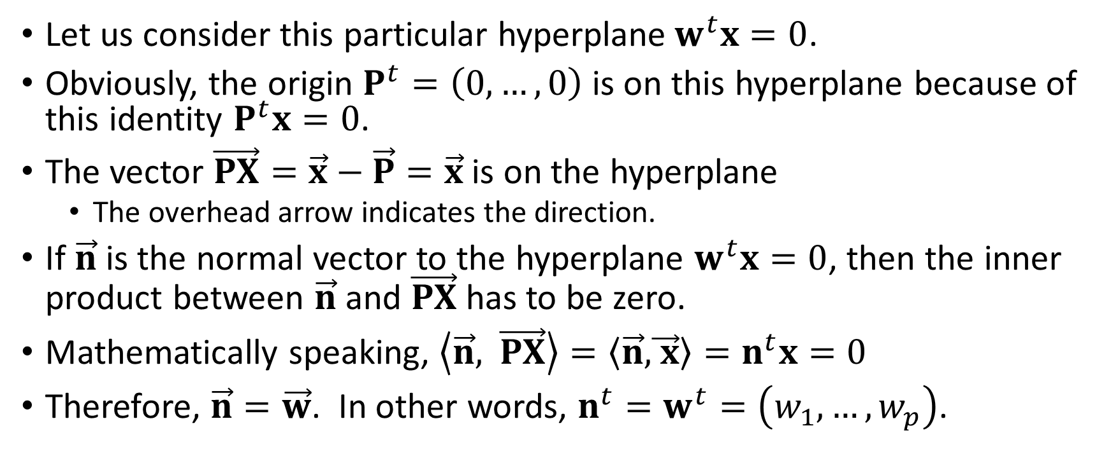
Normal Vector of a Hyperplane (Advanced Material)
Let us consider this particular hyperplane$w^{t}x=0$.
Obviously, the origin $P^{t}=\left(0,…,0\right)$ is on this hyperplane because of this identity $P^{t}x=0$.
The vector $\vec{PX}=\vec{x}−\vec{P}=\vec{x}$ is on the hyperplane
The overhead arrow indicates the direction.
If $\vec{n}$ is the normal vector to the hyperplane $w^{t}x=0$, then the inner product between $\vec{n}$ and $\vec{PX}$has to be zero.
Mathematically speaking, $\left\langle \vec{n}\text{,} \vec{PX}\right\rangle =\left\langle \vec{n}\text{,}\vec{ x}\right\rangle =n^{t}x=0$
Therefore, $\vec{n}=\vec{w}$. In other words, $n^{t}=w^{t}=\left(w_{1},…,w_{p}\right)$.

Slide 43
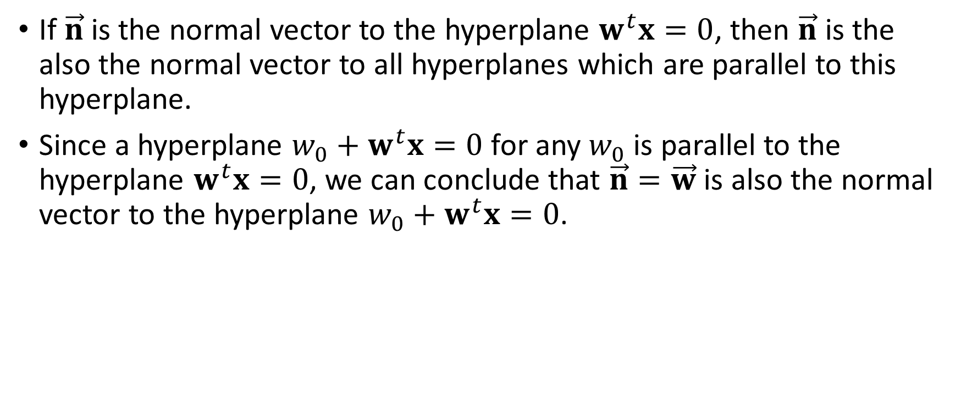
Normal Vector of a Hyperplane (Advanced Material)
If $\vec{n}$ is the normal vector to the hyperplane $w^{t}x=0$, then $\vec{n}$ is the also the normal vector to all hyperplanes which are parallel to this hyperplane.
Since a hyperplane $w_{0}+w^{t}x=0$ for any $w_{0}$ is parallel to the hyperplane $w^{t}x=0$, we can conclude that $\vec{n}=\vec{w}$ is also the normal vector to the hyperplane $w_{0}+w^{t}x=0$.

Slide 44
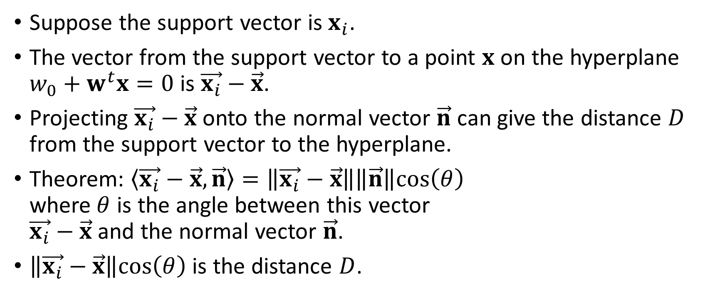
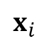
Distance from the Support Vector to a Hyperplane
Suppose the support vector is $x_{i}$.
The vector from the support vector to a point $x$ on the hyperplane $w_{0}+w^{t}x=0$ is $\vec{x_{i}}−\vec{x}$.
Projecting $\vec{x_{i}}−\vec{x}$ onto the normal vector $\vec{n}$ can give the distance $D$ from the support vector to the hyperplane.
Theorem: $\left\langle \vec{x_{i}}−\vec{x}, \vec{n}\right\rangle =\left\|\vec{x_{i}}−\vec{x}\right\|\left\|\vec{n}\right\|cos\left(θ\right)$ where$θ$ is the angle between this vector $\vec{x_{i}}−\vec{x}$ and the normal vector $\vec{n}$.
$\left\|\vec{x_{i}}−\vec{x}\right\|cos\left(θ\right)$ is the distance $D$.
$$x_{i}$$

Slide 45
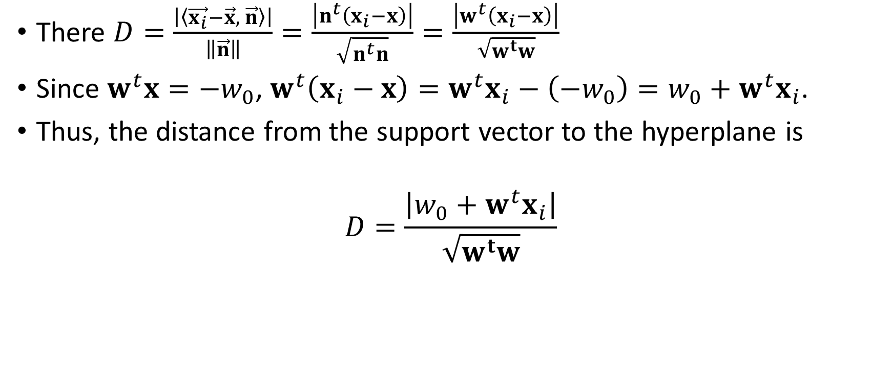
Distance from the Support Vector to a Hyperplane
There $D=\frac{\left|\left\langle \vec{x_{i}}−\vec{x}, \vec{n}\right\rangle \right|}{\left\|\vec{n}\right\|}=\frac{\left|n^{t}\left(x_{i}−x\right)\right|}{\sqrt{n^{t}n}}=\frac{\left|w^{t}\left(x_{i}−x\right)\right|}{\sqrt{w^{t}w}}$
Since $w^{t}x=−w_{0}$, $w^{t}\left(x_{i}−x\right)=w^{t}x_{i}−\left(−w_{0}\right)=w_{0}+w^{t}x_{i}$.
Thus, the distance from the support vector to the hyperplane is
$$D=\frac{\left|w_{0}+w^{t}x_{i}\right|}{\sqrt{w^{t}w}}$$
Source: https://www.ditutor.com/space/normal_vector.html

Slide 46
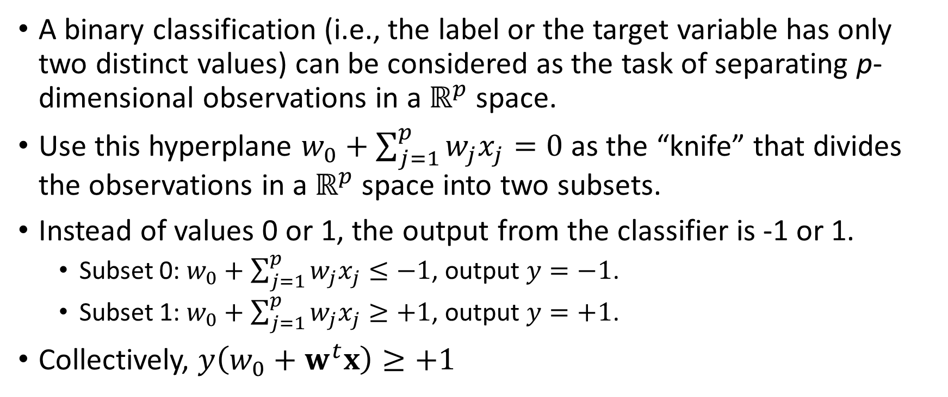
From Perceptron to Support Vector Machines
A binary classification (i.e., the label or the target variable has only two distinct values) can be considered as the task of separating p-dimensional observations in a $ℝ^{p}$ space.
Use this hyperplane $w_{0}+\sum_{j=1}^{p}{w_{j}x_{j}=0}$ as the “knife” that divides the observations in a $ℝ^{p}$ space into two subsets.
Instead of values 0 or 1, the output from the classifier is -1 or 1.
Subset 0: $w_{0}+\sum_{j=1}^{p}{w_{j}x_{j}≤−1}$, output $y=−1$.
Subset 1: $w_{0}+\sum_{j=1}^{p}{w_{j}x_{j}≥+1}$, output $y=+1$.
Collectively, $y\left(w_{0}+w^{t}x\right)≥+1$

Slide 47
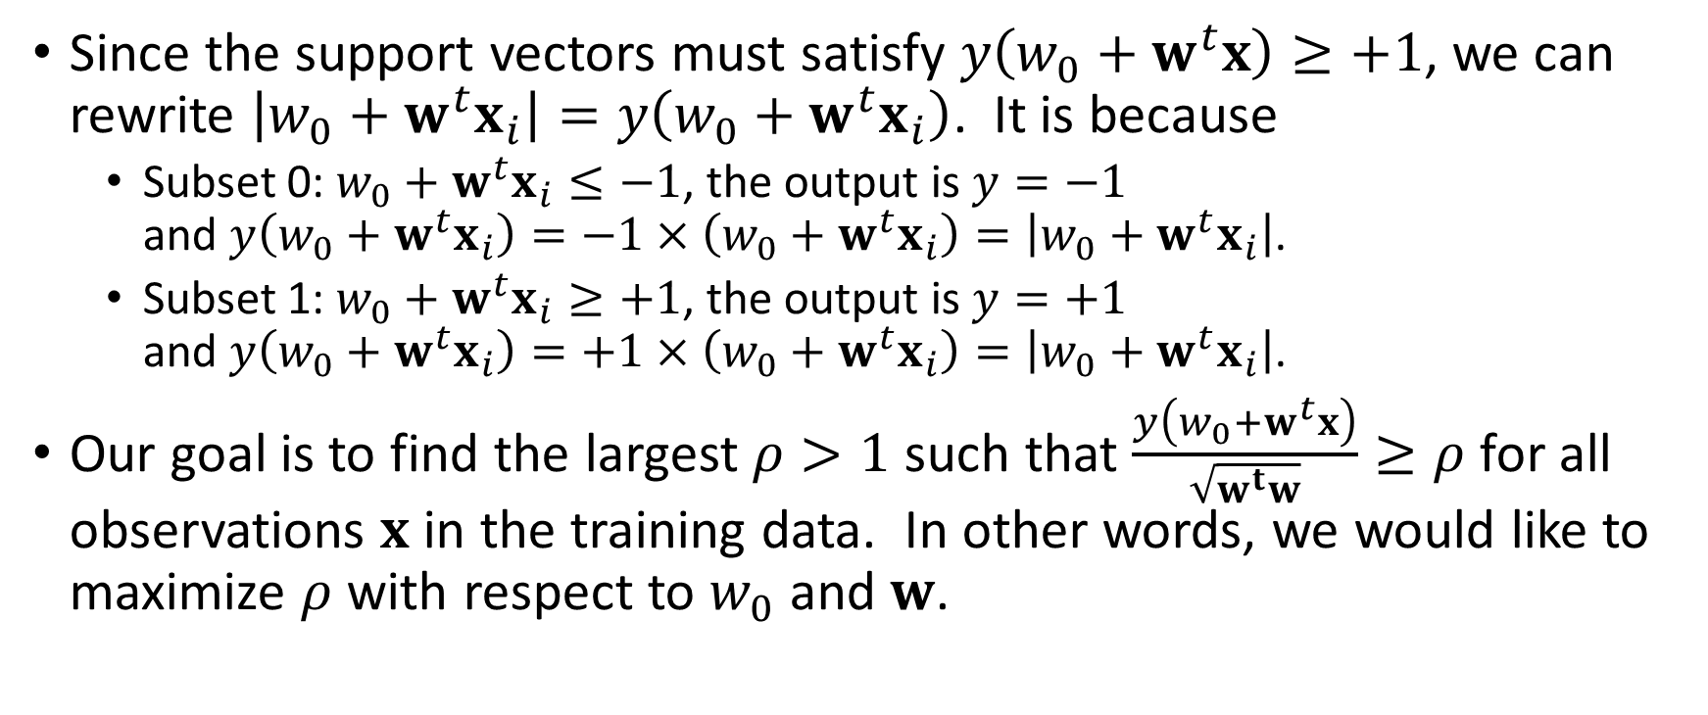
Maximizing the Margin
Since the support vectors must satisfy $y\left(w_{0}+w^{t}x\right)≥+1$, we can rewrite $\left|w_{0}+w^{t}x_{i}\right|=y\left(w_{0}+w^{t}x_{i}\right)$. It is because
Subset 0: $w_{0}+w^{t}x_{i}≤−1$, the output is $y=−1$ and $y\left(w_{0}+w^{t}x_{i}\right)=−1×\left(w_{0}+w^{t}x_{i}\right)=\left|w_{0}+w^{t}x_{i}\right|$.
Subset 1: $w_{0}+w^{t}x_{i}≥+1$, the output is $y=+1$ and $y\left(w_{0}+w^{t}x_{i}\right)=+1×\left(w_{0}+w^{t}x_{i}\right)=\left|w_{0}+w^{t}x_{i}\right|$.
Our goal is to find the largest $ρ>1$ such that $\frac{y\left(w_{0}+w^{t}x\right)}{\sqrt{w^{t}w}}≥ρ$ for all observations $x$ in the training data. In other words, we would like to maximize $ρ$ with respect to $w_{0}$ and $w$.

Slide 48
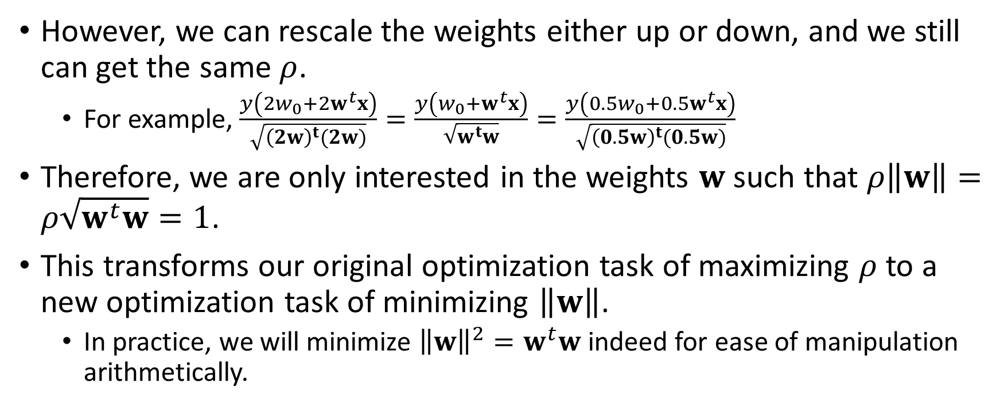
Minimizing the Norm of the Weights
However, we can rescale the weights either up or down, and we still can get the same $ρ$.
For example, $\frac{y\left(2w_{0}+2w^{t}x\right)}{\sqrt{{\left(2w\right)}^{t}(2w)}}=\frac{y\left(w_{0}+w^{t}x\right)}{\sqrt{w^{t}w}}=\frac{y\left(0.5w_{0}+0.5w^{t}x\right)}{\sqrt{{\left(0.5w\right)}^{t}(0.5w)}}$
Therefore, we are only interested in the weights $w$ such that $ρ\left\|w\right\|=ρ\sqrt{w^{t}w}=1$.
This transforms our original optimization task of maximizing $ρ$ to a new optimization task of minimizing $\left\|w\right\|$.
In practice, we will minimize ${\left\|w\right\|}^{2}=w^{t}w$ indeed for ease of manipulation arithmetically.

Slide 49
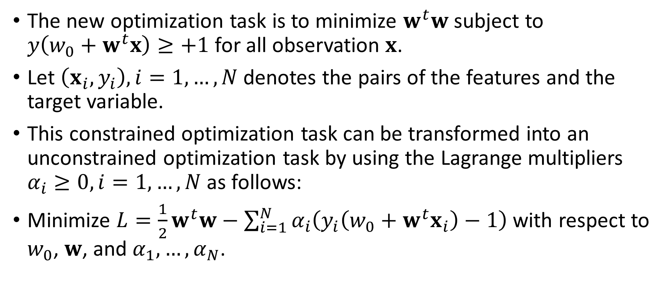
The Unconstrained Minimization Problem
The new optimization task is to minimize $w^{t}w$ subject to $y\left(w_{0}+w^{t}x\right)≥+1$ for all observation $x$.
Let $\left(x_{i},y_{i}\right),i=1,…,N$ denotes the pairs of the features and the target variable.
This constrained optimization task can be transformed into an unconstrained optimization task by using the Lagrange multipliers $α_{i}≥0, i=1,…,N$ as follows:
Minimize $L=\frac{1}{2}w^{t}w−\sum_{i=1}^{N}{α_{i}\left(y_{i}\left(w_{0}+w^{t}x_{i}\right)−1\right)}$ with respect to $w_{0}$, $w$, and $α_{1},…,α_{N}$.

Slide 50
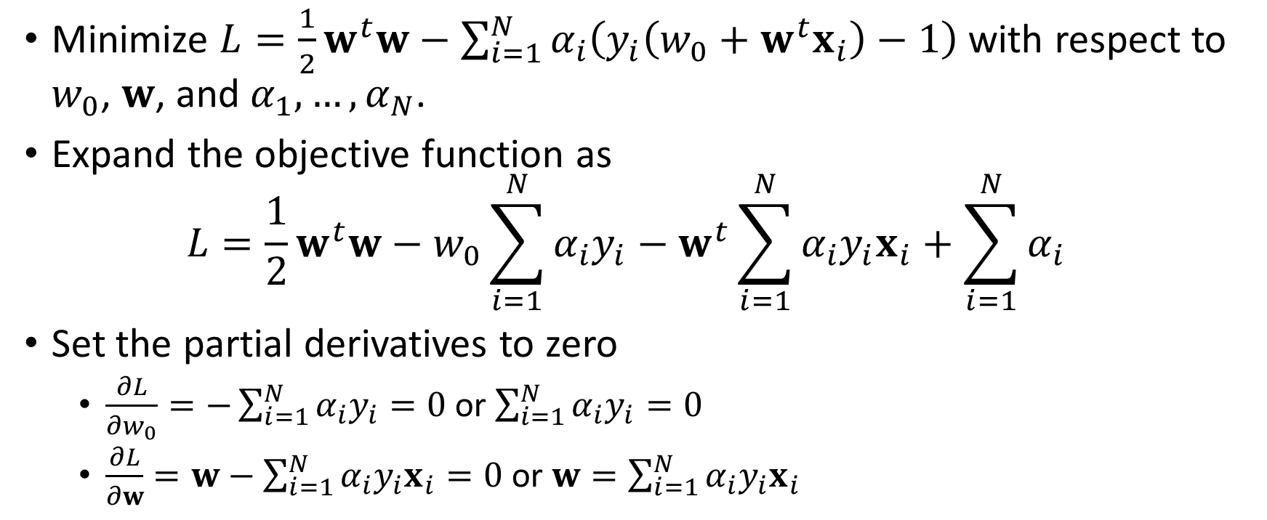
The Unconstrained Minimization Problem
Minimize $L=\frac{1}{2}w^{t}w−\sum_{i=1}^{N}{α_{i}\left(y_{i}\left(w_{0}+w^{t}x_{i}\right)−1\right)}$ with respect to $w_{0}$, $w$, and $α_{1},…,α_{N}$.
Expand the objective function as $L=\frac{1}{2}w^{t}w−w_{0}\sum_{i=1}^{N}{α_{i}y_{i}}−w^{t}\sum_{i=1}^{N}{α_{i}y_{i}x_{i}}+\sum_{i=1}^{N}{α_{i}}$
Set the partial derivatives to zero
$\frac{∂L}{∂w_{0}}=−\sum_{i=1}^{N}{α_{i}y_{i}}=0$ or $\sum_{i=1}^{N}{α_{i}y_{i}}=0$
$\frac{∂L}{∂w}=w−\sum_{i=1}^{N}{α_{i}y_{i}x_{i}}=0$ or $w=\sum_{i=1}^{N}{α_{i}y_{i}x_{i}}$

Slide 51
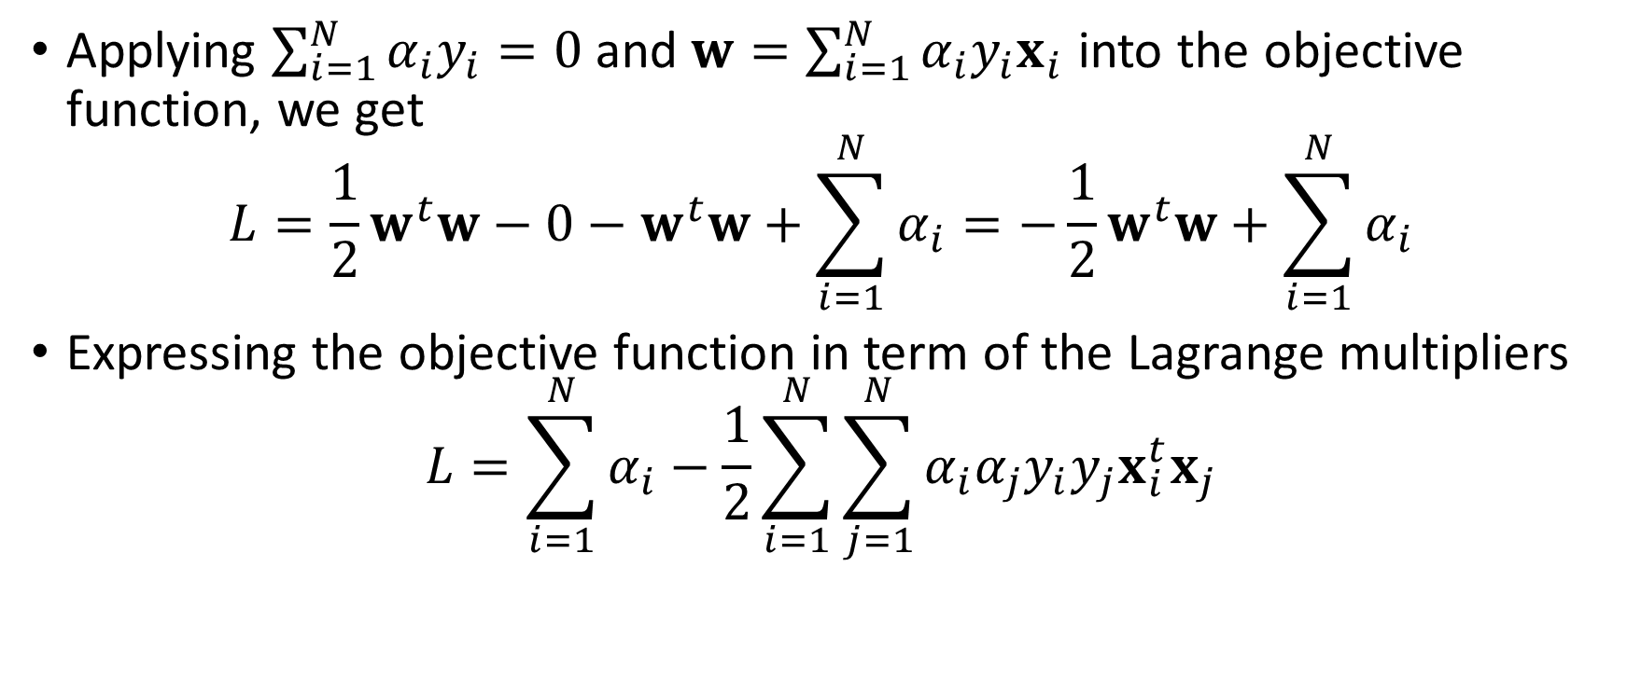
The Unconstrained Minimization Problem
Applying $\sum_{i=1}^{N}{α_{i}y_{i}}=0$ and $w=\sum_{i=1}^{N}{α_{i}y_{i}x_{i}}$ into the objective function, we get
$$L=\frac{1}{2}w^{t}w−0−w^{t}w+\sum_{i=1}^{N}{α_{i}}=−\frac{1}{2}w^{t}w+\sum_{i=1}^{N}{α_{i}}$$
Expressing the objective function in term of the Lagrange multipliers
$$L=\sum_{i=1}^{N}{α_{i}}−\frac{1}{2}\sum_{i=1}^{N}{\sum_{j=1}^{N}{α_{i}α_{j}y_{i}y_{j}x_{i}^{t}x_{j}}}$$

Slide 52
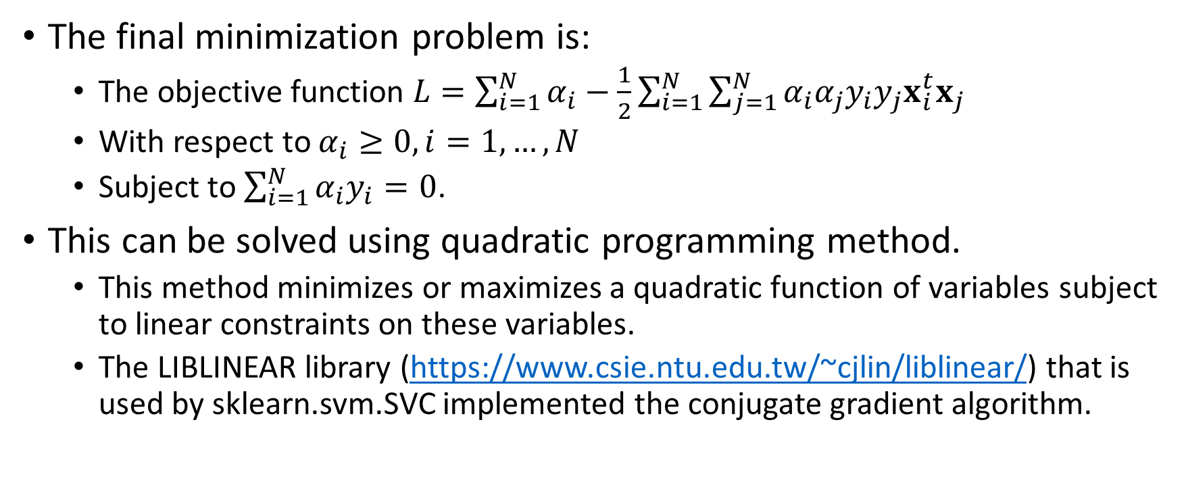
The Unconstrained Minimization Problem (End of Advanced Material)
The final minimization problem is:
The objective function $L=\sum_{i=1}^{N}{α_{i}}−\frac{1}{2}\sum_{i=1}^{N}{\sum_{j=1}^{N}{α_{i}α_{j}y_{i}y_{j}x_{i}^{t}x_{j}}}$
With respect to $α_{i}≥0,i=1,…,N$
Subject to $\sum_{i=1}^{N}{α_{i}y_{i}}=0$.
This can be solved using quadratic programming method.
This method minimizes or maximizes a quadratic function of variables subject to linear constraints on these variables.
The LIBLINEAR library (https://www.csie.ntu.edu.tw/~cjlin/liblinear/) that is used by sklearn.svm.SVC implemented the conjugate gradient algorithm.

Slide 53
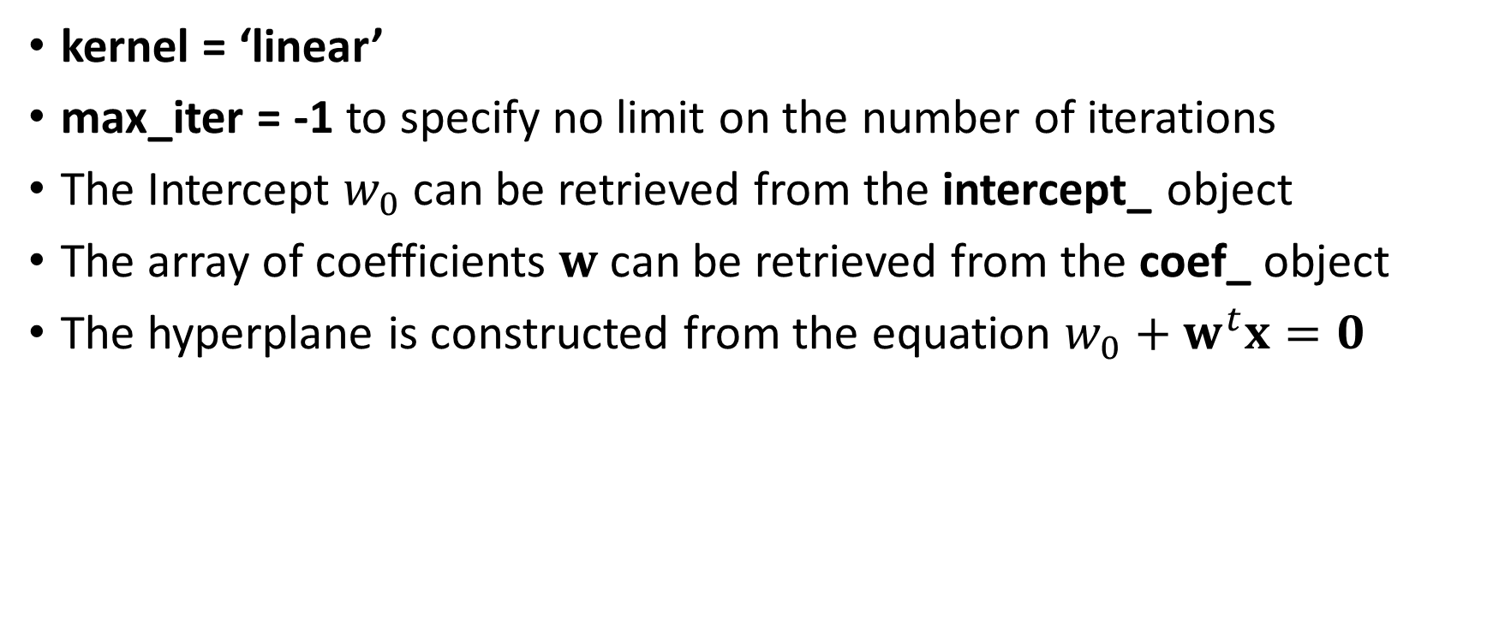
sklearn.svm.SVC() Function
kernel = ‘linear’
max_iter = -1 to specify no limit on the number of iterations
The Intercept $w_{0}$can be retrieved from the intercept_ object
The array of coefficients $w$ can be retrieved from the coef_ object
The hyperplane is constructed from the equation $w_{0}+w^{t}x=0$

Slide 54
Support Vector Machine
xTrain = trainData[['X','Y']]
yTrain = trainData['Group']
svm_Model = svm.SVC(kernel = 'linear', random_state = 20191106, max_iter = -1)
thisFit = svm_Model.fit(xTrain, yTrain)
y_predictClass = thisFit.predict(xTrain)
print('Mean Accuracy = ', metrics.accuracy_score(yTrain, y_predictClass))
trainData['_PredictedClass_'] = y_predictClass
svm_Mean = trainData.groupby('_PredictedClass_').mean()
# get the separating hyperplane
w = thisFit.coef_[0]
a = -w[0] / w[1]
xx = numpy.linspace(-3, 3)
yy = a * xx - (thisFit.intercept_[0]) / w[1]
# plot the parallels to the separating hyperplane that pass through the
# support vectors
b = thisFit.support_vectors_[0]
yy_down = a * xx + (b[1] - a * b[0])
b = thisFit.support_vectors_[-1]
yy_up = a * xx + (b[1] - a * b[0])
Week 12 Identify MVN100.py

Slide 55
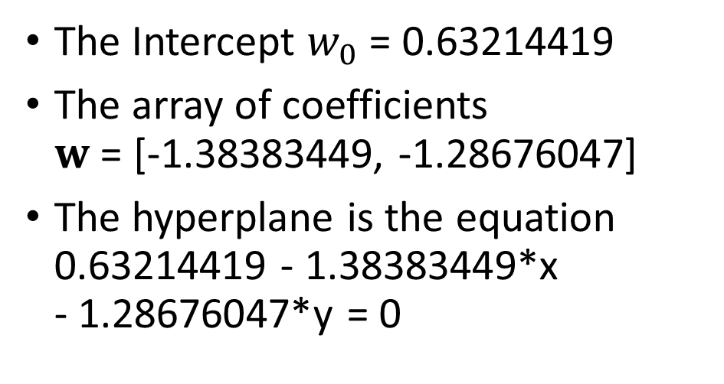
Support Vector Machine
The Intercept $w_{0}$= 0.63214419
The array of coefficients $w$ = [-1.38383449, -1.28676047]
The hyperplane is the equation 0.63214419 - 1.38383449*x - 1.28676047*y = 0
Week 12 Identify MVN100.py
Zero misclassification rate!

Slide 56
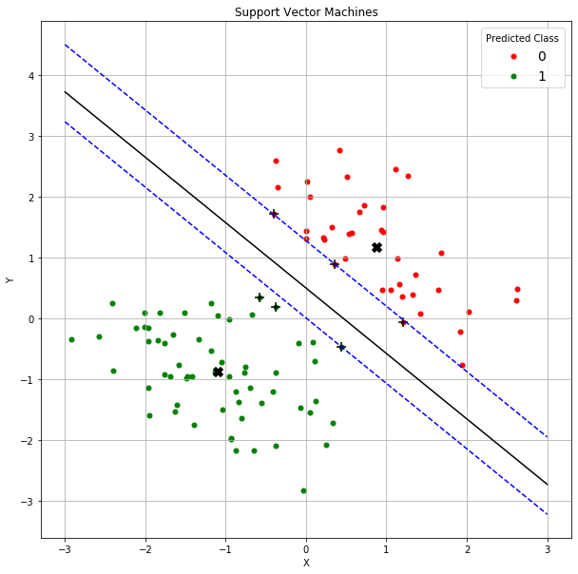
Support Vector Machine
The Support Vectors (x,y) below are marked ‘+’ in the chart:
(-0.407005, 1.70643)
(0.359291, 0.881862)
(1.20526, -0.0701964)
(-0.573146, 0.330351)
(-0.37771, 0.176027)
(0.441466, -0.475426)

Slide 57
The Support Vector Machine Solution
Separating Hyperplane
Group 0 Centroid
X = -1.10193414
Y = -0.88805487
Group 1 Centroid
X = 0.88152581
Y = 1.17125693
Support Vectors
Support Vectors

Slide 58
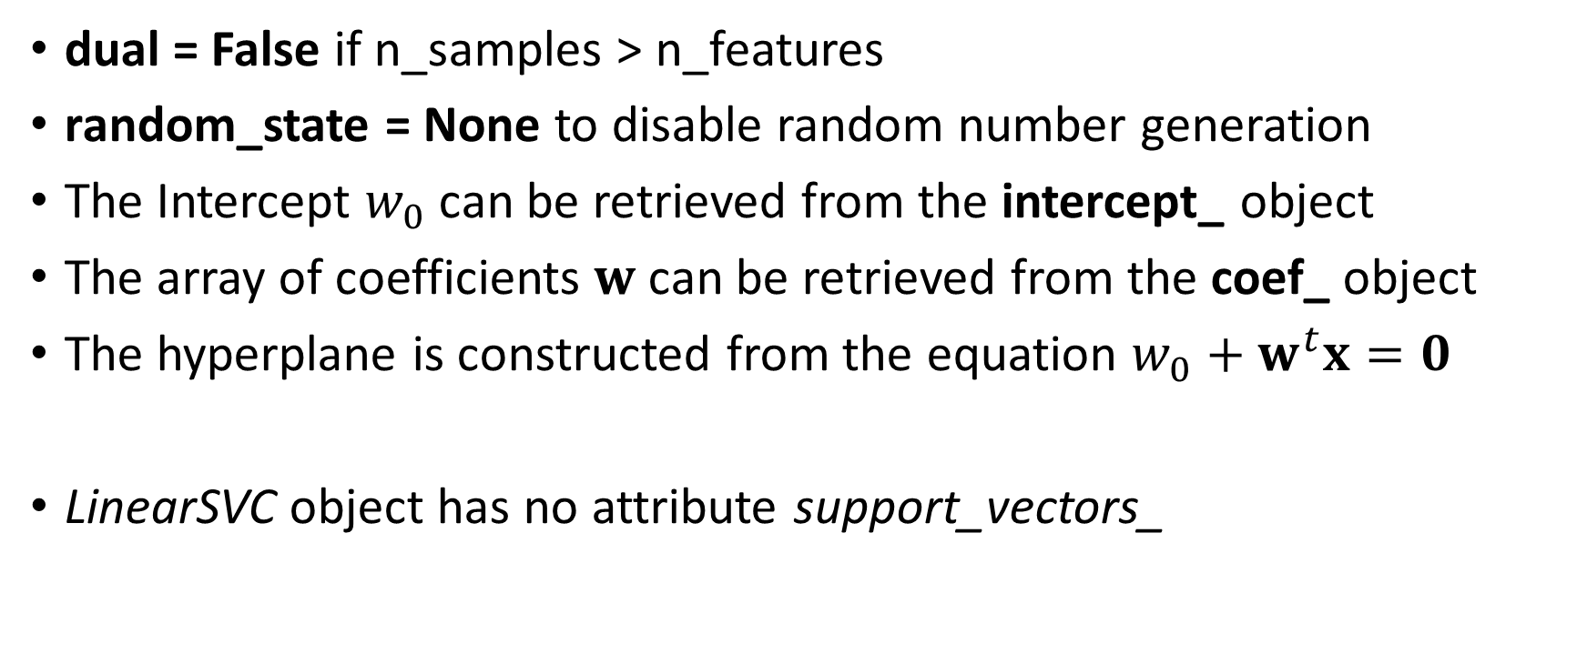
sklearn.svm.LinearSVC() Function
dual = False if n_samples > n_features
random_state = None to disable random number generation
The Intercept $w_{0}$can be retrieved from the intercept_ object
The array of coefficients $w$ can be retrieved from the coef_ object
The hyperplane is constructed from the equation $w_{0}+w^{t}x=0$
LinearSVC object has no attribute support_vectors_

Slide 59
Feature Selection
Enter one feature sequentially
Enter the feature that yields the lowest misclassification rate
Stop if the misclassification rate does not decrease
HMEQ data
Target is BAD
Categories: 0 and 1

Slide 60
HMEQ Data: Step 1
Week 12 HMEQ SVM.py
Included Features is empty
Candidate Features: CLAGE, CLNO, DELINQ, DEROG, NINQ, YOJ
hmeq = pandas.read_csv('C:\\Users\\minlam\\Documents\\IIT\\Machine Learning\\Data\\HMEQ.csv',
delimiter=',')
y_name = 'BAD'
# Set dual = False because n_samples > n_features
accuracyResult = pandas.DataFrame()
includeVar = []
X_name = ['CLAGE','CLNO','DELINQ','DEROG','NINQ','YOJ']
for ivar in X_name:
inputData = hmeq[includeVar + [y_name, ivar]].dropna()
X = inputData[includeVar + [ivar]]
y = inputData[y_name].astype('category')
svm_Model = svm.LinearSVC(verbose = 1, dual = False, random_state = None, max_iter = 10000)
thisFit = svm_Model.fit(X, y)
y_predictClass = thisFit.predict(X)
y_predictAccuracy = metrics.accuracy_score(y, y_predictClass)
accuracyResult = accuracyResult.append([[includeVar + [ivar], inputData.shape[0], y_predictAccuracy]], ignore_index = True)

Slide 61
HMEQ Data: Step 1
Included Features is empty
Candidate Features: CLAGE, CLNO, DELINQ, DEROG, NINQ, YOJ
Enter YOJ
Feature | N Samples | Misclassification
YOJ | 5445 | 0.79357
NINQ | 5450 | 0.79431
CLNO | 5738 | 0.80202
DEROG | 5252 | 0.80236
CLAGE | 5652 | 0.80343
DELINQ | 5380 | 0.81152

Slide 62
HMEQ Data: Step 2
Included Feature: YOJ
Candidate Features: CLAGE, CLNO, DELINQ, DEROG, NINQ
accuracyResult = pandas.DataFrame()
includeVar = ['YOJ']
X_name = ['CLAGE','CLNO','DELINQ','DEROG','NINQ']
for ivar in X_name:
inputData = hmeq[includeVar + [y_name, ivar]].dropna()
X = inputData[includeVar + [ivar]]
y = inputData[y_name].astype('category')
svm_Model = svm.LinearSVC(verbose = 1, dual = False, random_state = None, max_iter = 10000)
thisFit = svm_Model.fit(X, y)
y_predictClass = thisFit.predict(X)
y_predictAccuracy = metrics.accuracy_score(y, y_predictClass)
accuracyResult = accuracyResult.append([[includeVar + [ivar], inputData.shape[0], y_predictAccuracy]],
ignore_index = True)

Slide 63
HMEQ Data: Step 2
Included Feature: YOJ
Candidate Features: CLAGE, CLNO, DELINQ, DEROG, NINQ
Enter NINQ
Feature | N Samples | Misclassification
YOJ, NINQ | 5127 | 0.79013
YOJ, CLNO | 5340 | 0.79719
YOJ, CLAGE | 5271 | 0.79928
YOJ, DEROG | 4914 | 0.80362
YOJ, DELINQ | 5059 | 0.80945

Slide 64
HMEQ Data: Step 3
Included Feature: YOJ, NINQ
Candidate Features: CLAGE, CLNO, DELINQ, DEROG
accuracyResult = pandas.DataFrame()
includeVar = ['YOJ', 'NINQ']
X_name = ['CLAGE','CLNO','DELINQ','DEROG']
for ivar in X_name:
inputData = hmeq[includeVar + [y_name, ivar]].dropna()
X = inputData[includeVar + [ivar]]
y = inputData[y_name].astype('category')
svm_Model = svm.LinearSVC(verbose = 1, dual = False, random_state = None, max_iter = 10000)
thisFit = svm_Model.fit(X, y)
y_predictClass = thisFit.predict(X)
y_predictAccuracy = metrics.accuracy_score(y, y_predictClass)
accuracyResult = accuracyResult.append([[includeVar + [ivar], inputData.shape[0], y_predictAccuracy]],
ignore_index = True)

Slide 65
HMEQ Data: Step 3
Included Feature: YOJ, NINQ
Candidate Features: CLAGE, CLNO, DELINQ, DEROG
Enter CLNO
Feature | N Samples | Misclassification
YOJ, NINQ, CLNO | 5127 | 0.79091
YOJ, NINQ, CLAGE | 5058 | 0.79439
YOJ, NINQ, DEROG | 4837 | 0.80132
YOJ, NINQ, DELINQ | 4983 | 0.81617

Slide 66
HMEQ Data: Step 4
Included Feature: YOJ, NINQ, CLNO
Candidate Features: CLAGE, DELINQ, DEROG
accuracyResult = pandas.DataFrame()
includeVar = ['YOJ', 'NINQ', 'CLNO']
X_name = ['CLAGE','DELINQ','DEROG']
for ivar in X_name:
inputData = hmeq[includeVar + [y_name, ivar]].dropna()
X = inputData[includeVar + [ivar]]
y = inputData[y_name].astype('category')
svm_Model = svm.LinearSVC(verbose = 1, dual = False, random_state = None, max_iter = 10000)
thisFit = svm_Model.fit(X, y)
y_predictClass = thisFit.predict(X)
y_predictAccuracy = metrics.accuracy_score(y, y_predictClass)
accuracyResult = accuracyResult.append([[includeVar + [ivar], inputData.shape[0], y_predictAccuracy]],
ignore_index = True)

Slide 67
HMEQ Data: Step 4
Included Feature: YOJ, NINQ, CLNO
Candidate Features: CLAGE, DELINQ, DEROG
Enter CLAGE
Feature | N Samples | Misclassification
YOJ, NINQ, CLNO, CLAGE | 5058 | 0.79439
YOJ, NINQ, CLNO, DELINQ | 4983 | 0.81698
YOJ, NINQ, CLNO, DEROG | 4837 | 0.80091

Slide 68
HMEQ Data: Step 5
Included Feature: YOJ, NINQ, CLNO, CLAGE
Candidate Features: DELINQ, DEROG
accuracyResult = pandas.DataFrame()
includeVar = ['YOJ', 'NINQ', 'CLNO', 'CLAGE']
X_name = ['DELINQ','DEROG']
for ivar in X_name:
inputData = hmeq[includeVar + [y_name, ivar]].dropna()
X = inputData[includeVar + [ivar]]
y = inputData[y_name].astype('category')
svm_Model = svm.LinearSVC(verbose = 1, dual = False, random_state = None, max_iter = 10000)
thisFit = svm_Model.fit(X, y)
y_predictClass = thisFit.predict(X)
y_predictAccuracy = metrics.accuracy_score(y, y_predictClass)
accuracyResult = accuracyResult.append([[includeVar + [ivar], inputData.shape[0], y_predictAccuracy]],
ignore_index = True)

Slide 69
HMEQ Data: Step 5
Included Feature: YOJ, NINQ, CLNO, CLAGE
Candidate Features: DELINQ, DEROG
Enter DEROG
Feature | N Samples | Misclassification
YOJ, NINQ, CLNO, CLAGE, DEROG | 4768 | 0.80998
YOJ, NINQ, CLNO, CLAGE, DELINQ | 4914 | 0.82011

Slide 70
HMEQ Data: Step 6
Included Feature: YOJ, NINQ, CLNO, CLAGE, DEROG
Candidate Features: DELINQ
accuracyResult = pandas.DataFrame()
includeVar = ['YOJ', 'NINQ', 'CLNO', 'CLAGE', 'DEROG']
X_name = ['DELINQ']
for ivar in X_name:
inputData = hmeq[includeVar + [y_name, ivar]].dropna()
X = inputData[includeVar + [ivar]]
y = inputData[y_name].astype('category')
svm_Model = svm.LinearSVC(verbose = 1, dual = False, random_state = None, max_iter = 10000)
thisFit = svm_Model.fit(X, y)
y_predictClass = thisFit.predict(X)
y_predictAccuracy = metrics.accuracy_score(y, y_predictClass)
accuracyResult = accuracyResult.append([[includeVar + [ivar], inputData.shape[0], y_predictAccuracy]],
ignore_index = True)

Slide 71
HMEQ Data: Step 6
Included Feature: YOJ, NINQ, CLNO, CLAGE, DEROG
Candidate Features: DELINQ
Enter DELINQ
Feature | N Samples | Misclassification
YOJ, NINQ, CLNO, CLAGE, DEROG, DELINQ | 4748 | 0.83151

Slide 72
HMEQ Data: Step Summary
Step | Feature | N Samples | Misclassification
1 | YOJ | 5445 | 0.79357
2 | YOJ, NINQ | 5127 | 0.79013
3 | YOJ, NINQ, CLNO | 5127 | 0.79091
4 | YOJ, NINQ, CLNO, CLAGE | 5058 | 0.79439
5 | YOJ, NINQ, CLNO, CLAGE, DEROG | 4768 | 0.80998
6 | YOJ, NINQ, CLNO, CLAGE, DEROG, DELINQ | 4748 | 0.83151
Consider to stop at Step #2 or Step #3
My choice of the optimal feature set: {YOJ, NINQ}

Slide 73
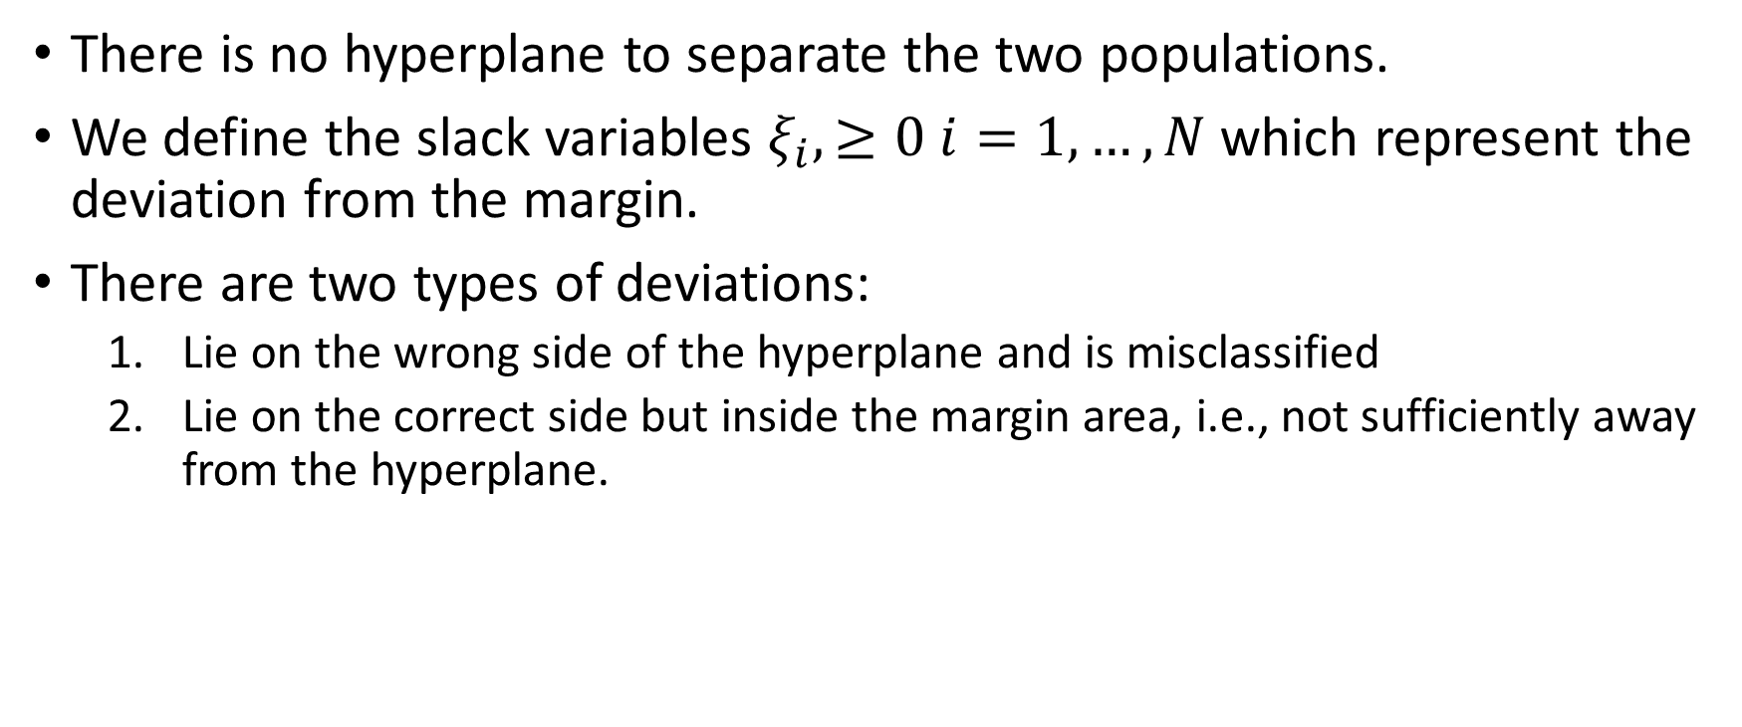
The Non-separable Case
There is no hyperplane to separate the two populations.
We define the slack variables $ξ_{i},≥0 i=1,…,N$ which represent the deviation from the margin.
There are two types of deviations:
Lie on the wrong side of the hyperplane and is misclassified
Lie on the correct side but inside the margin area, i.e., not sufficiently away from the hyperplane.

Slide 74
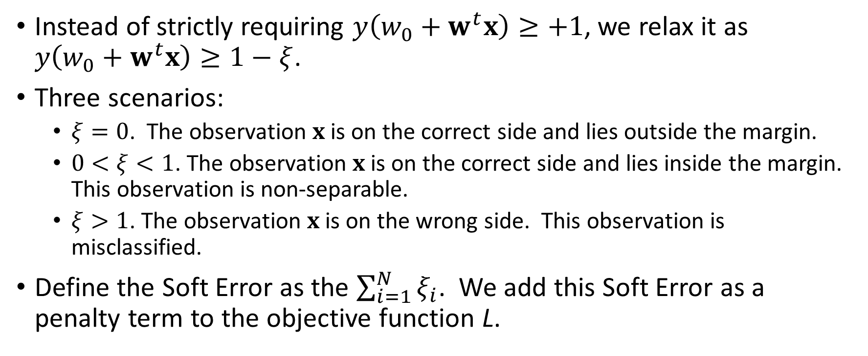
The Non-separable Case
Instead of strictly requiring $y\left(w_{0}+w^{t}x\right)≥+1$, we relax it as $y\left(w_{0}+w^{t}x\right)≥1−ξ$.
Three scenarios:
$ξ=0$. The observation $x$ is on the correct side and lies outside the margin.
$0<ξ<1$. The observation $x$ is on the correct side and lies inside the margin. This observation is non-separable.
$ξ>1$. The observation $x$ is on the wrong side. This observation is misclassified.
Define the Soft Error as the $\sum_{i=1}^{N}{ξ_{i}}$. We add this Soft Error as a penalty term to the objective function L.

Slide 75

The Non-separable Case
Define the Hinge Loss as the estimated Soft Error.
It is zero if $y\left(w_{0}+w^{t}x\right)≥+1$ (i.e., $ξ=0$)
It is $1−y\left(w_{0}+w^{t}x\right)$ otherwise (i.e., $0<ξ<1$ or $ξ>1$)
Specifying the Hinge Loss will make the margin narrower than the optimal, and to re-position the hyperplane in the margin away from the support vectors.

Slide 76
Multi-Class Target Variable
If the target variable has more than two categories, the classification can be done in
OVO: One class versus another class. One SVM classifier for each pair of classes.
OVR: One class versus all the other classes. One SVM classifier for each pair of a class versus the otherwise.
The SVC() function recommends OVR because the OVO method has been deprecated.

Slide 77

Three Shells Example
Week 12 SVM Three Segment.py
Three Target Classes
The three shells meet at the origin (0,0)

Slide 78
Use SVM to Determine Linear Separator?
# Build Support Vector Machine classifier
xTrain = trainData[['X','Y']]
yTrain = trainData['Group']
svm_Model = svm.SVC(kernel = 'linear’,
decision_function_shape = 'ovr’,
random_state = 20191106, max_iter = -1)
thisFit = svm_Model.fit(xTrain, yTrain)
y_predictClass = thisFit.predict(xTrain)
print('Mean Accuracy = ', metrics.accuracy_score(yTrain, y_predictClass))
trainData['_PredictedClass_'] = y_predictClass
print('Intercept = ', thisFit.intercept_)
print('Coefficients = ', thisFit.coef_)
# get the separating hyperplane
xx = numpy.linspace(-6, 6)
yy = numpy.zeros((len(xx),3))
for j in range(3):
w = thisFit.coef_[j,:]
a = -w[0] / w[1]
yy[:,j] = a * xx - (thisFit.intercept_[j]) / w[1]

Slide 79
Three Shells Example
One Class Over the Rest (OVR) performs the SVM three times.
Group 1 versus Group 2 & 3
Group 2 versus Group 1 & 3
Group 3 versus Group 1 & 2
Each SVM generates one hyperplane
Score an observation based on each hyperplane.
Assign to the highest score group
Hyperplane | Group 1 | Group 2 | Group 3
1 vs (2 & 3) | +1 | +0.5 | +0.5
2 vs (1 & 3) | +0.5 | +1 | +0.5
3 vs (1 & 2) | +0.5 | +0.5 | +1

Slide 80

Three Shells Example
Accuracy is 0.8148
The three hyperplanes are:
Obviously, the hyperplanes do not classify the three shells well!
Hyperplane | Intercept | X | Y
0 | -1.33201658 | 0.72885719 | 1.37117503
1 | -0.78031386 | 0.89138290 | 3.45622392
2 | 0.50821464 | -0.68709132 | -0.29486694

Slide 81
Three Shells Example
Polar Coordinates?
Transform a curve into a straight line

Slide 82

Convert to Polar Coordinates
# Convert to the polar coordinates
trainData['radius'] = numpy.sqrt(trainData['X']**2 +
trainData['Y']**2)
trainData['theta'] = numpy.arctan2(trainData['Y’],
trainData['X'])
# ArcTan2 gives angle from –Pi to Pi
# Make the angle from 0 to 2*Pi
def customArcTan (z):
theta = numpy.where(z < 0.0, 2.0*numpy.pi+z, z)
return (theta)
trainData['theta'] = trainData['theta'].apply(customArcTan)
# Build Support Vector Machine classifier
xTrain = trainData[['radius','theta']]
yTrain = trainData['Group']
Clearly, there are three separable segments under the Polar Coordinates

Slide 83

Convert to Polar Coordinates
xTrain = trainData[['radius','theta']]
yTrain = trainData['Group']
svm_Model = svm.SVC(kernel = 'linear', decision_function_shape = 'ovr',
random_state = 20191106, max_iter = -1)
thisFit = svm_Model.fit(xTrain, yTrain)
y_predictClass = thisFit.predict(xTrain)
print('Mean Accuracy = ', metrics.accuracy_score(yTrain, y_predictClass))
trainData['_PredictedClass_'] = y_predictClass
print('Intercept = ', thisFit.intercept_)
print('Coefficients = ', thisFit.coef_)
Mean Accuracy = 0.9693593314763231
Intercept = [ 0.44928429 -1. 4.21469585]
Coefficients = [[ 1.37802885 -2.41217043]
[ 2.67692307 -1.78461539]
[ 0.8200091 -1.31201103]]

Slide 84

Back to Cartesian Coordinates
# Back-transform the hyperplane from the Polar coordinates to the Cartesian coordinates
h0_xx = xx * numpy.cos(yy[:,0])
h0_yy = xx * numpy.sin(yy[:,0])
h1_xx = xx * numpy.cos(yy[:,1])
h1_yy = xx * numpy.sin(yy[:,1])
h2_xx = xx * numpy.cos(yy[:,2])
h2_yy = xx * numpy.sin(yy[:,2])
Except for the points near the origin, all the points are correctly classified.

Slide 85
Final Remarks
Support Vector Machines are primarily for classifying a binary target variable.
In addition to classification, Support Vector Machines provide the line in the sand. The line ensures that the margin between the line and the support vectors are widest. This helps the prediction of new data.
Support Vector Machines work well for groups of compact observations. However, it is likely to fail for groups of connected observations.
Consider transforming the data to another coordinate system such that the segments are more separable

Slide 86

Assignment 5
Submit your Python codes with your homework submission
Due date is 11:59 pm on Sunday, November 22, 2020

